Slide 1
PRESENTING SCIENTIFIC RESEARCH
Kira Mills
UTD Neuroscience Student Association
March 10, 2020

Slide 2
HELLO!
I am Kira Mills
I am a Ph.D. student in the Department of Chemistry & Biochemistry here at UTD

Slide 3

MY GOAL TODAY IS TO DISCUSS:
Picking and reading an article
Picking and reading an article
What to discuss in the presentation
What to discuss in the presentation
Designing a PowerPoint that works
Designing a PowerPoint that works
The basics of poster presentations
The basics of poster presentations

Slide 4
How should you prepare?
Find, read, and understand your article before you start making a presentation

Slide 5
While every field, journal, and article is unique, there is still a general flow and purpose of every article that we can follow

Slide 6
ORIGINAL RESEARCH IS USUALLY ORGANIZED THIS WAY:
What did we study and why?
How did we study it?
What did we learn about it?
Introduction
Background & Significance
Materials & Methods
Part of Results
Results
Discussion & Conclusions

Slide 7
WHERE TO LOOK FOR ARTICLES
The library’s website
A different database (SCOPUS, ScienceDirect, PubMed)
Can be found through the library
A journal’s website
The Journal of Neuroscience
Nature Neuroscience
The reference list of a different article

Slide 8
WHAT INFORMATION DO YOU NEED?
From the title and abstract
What are the main goals of the paper?
What were the high-level results?

Slide 9
WHAT INFORMATION DO YOU NEED?
From the introduction
What is this paper about? What problem is this trying to solve?
What are the authors trying to answer with their research?
What is the hypothesis (and null hypothesis)?
How does the author plan to answer this question?
What scientific terms were used that you need to look up?

Slide 10
WHAT INFORMATION DO YOU NEED?
From the methods and results
What were the main “types” of experiments they performed and why?
Summarize the results of the key tables or graphs.
How does each figure relate to the question being asked?

Slide 11
WHAT INFORMATION DO YOU NEED?
From the conclusion or discussion
What problems do the authors identify in the research?
Do the authors identify a direction for future research?
How did their experimental design answer their original questions or hypothesis?
Which results do they identify as key?

Slide 12
READ IT AGAIN
After initially reading each section, and annotating, go back through and read the paper again to see if you can understand how it all fits back together
You might not need to read every sentence, but make sure you can now follow their main points

Slide 13
TAKE NOTES
There are a lot of methods for taking notes that help, play around with a few to see what works best for you
Bullet-point or outline style
Answering the questions for each section
Create a flowchart or storyboard

Slide 14
FLOW-CHART OR STORYBOARD
This study: compare TENS, exercise, and immobilization in rat arthritis model
Immobilization = put plaster cast on rat leg
5 groups of 12 rats:
control
arthritis
immobilization
exercise
TENS
Induce arthritis in right knee joint
TENS = apply low-level electric stim. not enough for muscle contraction
PPT & PWR → measure to see how rats respond to pain
Test behavior
Exercise = use same device as TENS at higher intensity to cause muscle contraction
PPT: Exercise #1 and TENS #2
PWR: Exercise #1
Low-intensity muscle contraction reduced 1º and 2⁰ hyperalgesia by lowering amount macrophages
Exercise sig. better, TENS #2
Knee= look for CD68 + cells (lower = better)
Culture tissue from knee and spine
Exercise better in 3/4 , TENS #2
Spine = look for CGRP (peptide) (lower = better)

Slide 15
What should you include?
There is a lot of information given in a research article, but we don’t need all of it

Slide 16
KNOW YOUR AUDIENCE
This will guide
the background information you give
how much experimental detail to include
what sort of results can be discussed
how harshly you critique
how much of your own opinion to include

Slide 17
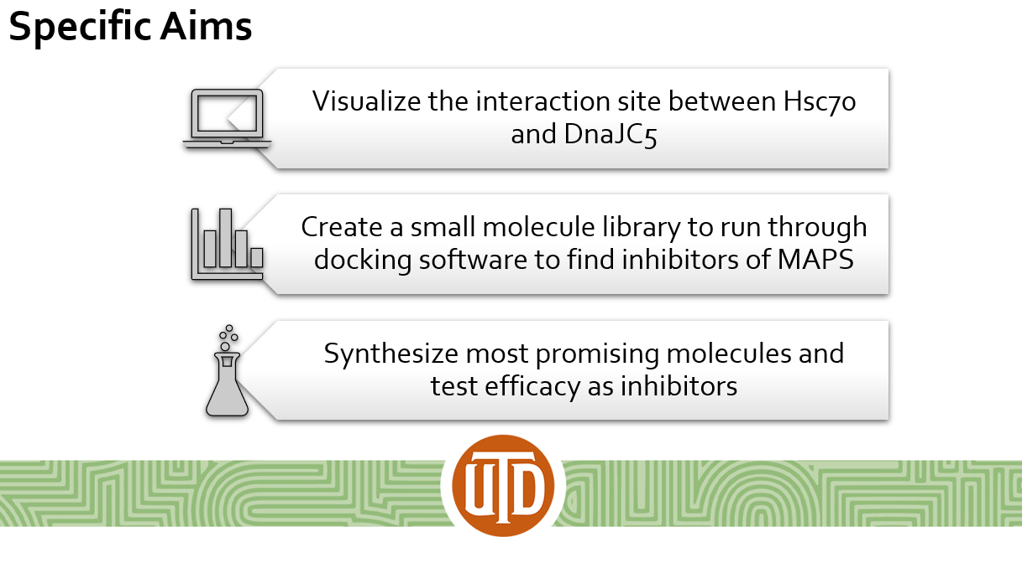
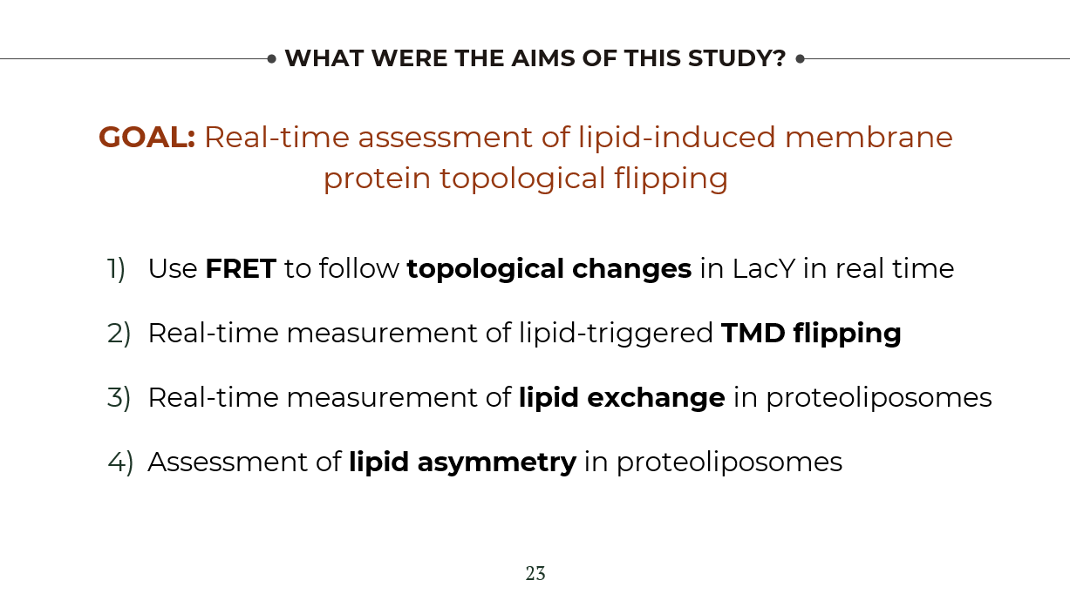
GIVE THE AUDIENCE A CHEAT-SHEET
Identify the main goals/questions of the article, and as you create slides you should determine how each thing relates back to a goal or answers a question

Slide 18
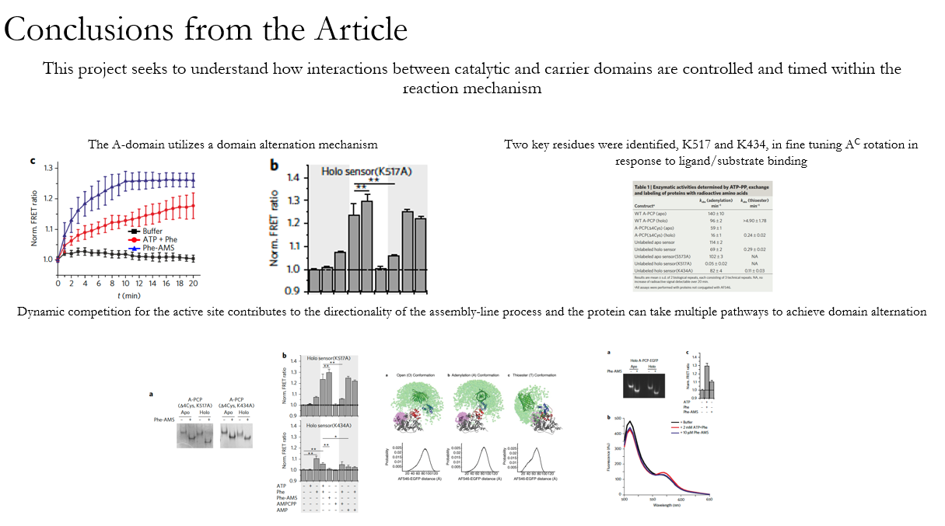
GIVE THE AUDIENCE A CHEAT-SHEET
You can even start your presentation with the main conclusions so that the audience knows what to expect and look for as you go through the rest

Slide 19
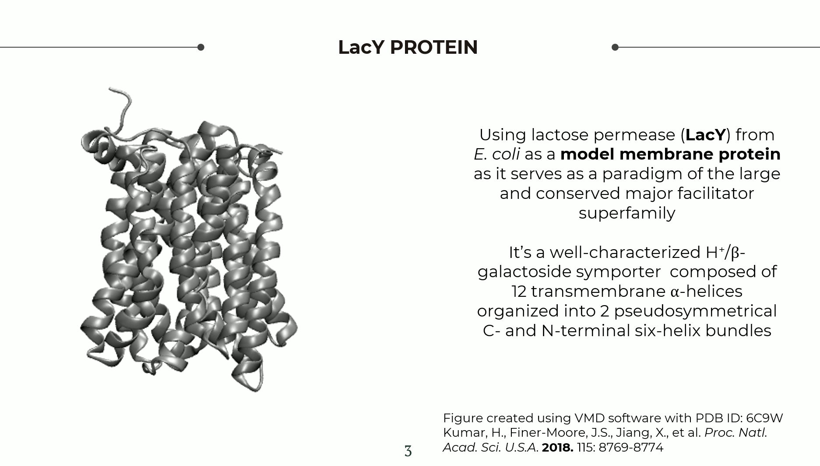
INTRODUCTION/BACKGROUND
You can use the introduction of the article to guide you, but you just need to make sure you include any information that is necessary to understand the goals and the motivation
If you want to discuss methodologies, you can include information here or during the “methods” section
You can use the introduction of the article to guide you, but you just need to make sure you include any information that is necessary to understand the goals and the motivation
If you want to discuss methodologies, you can include information here or during the “methods” section

Slide 20
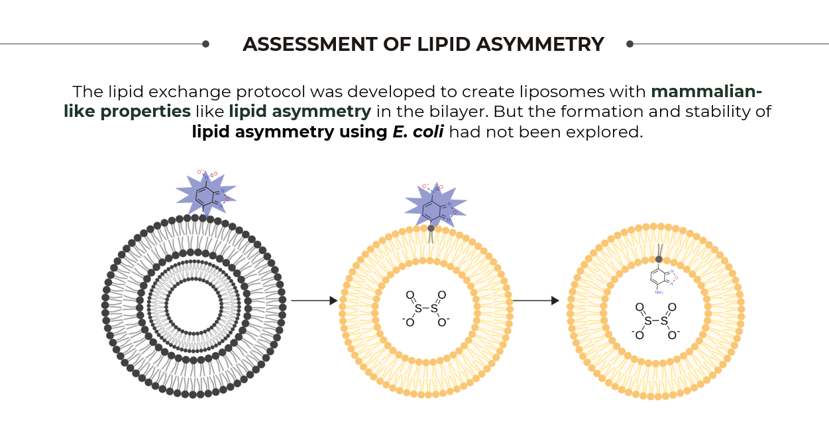
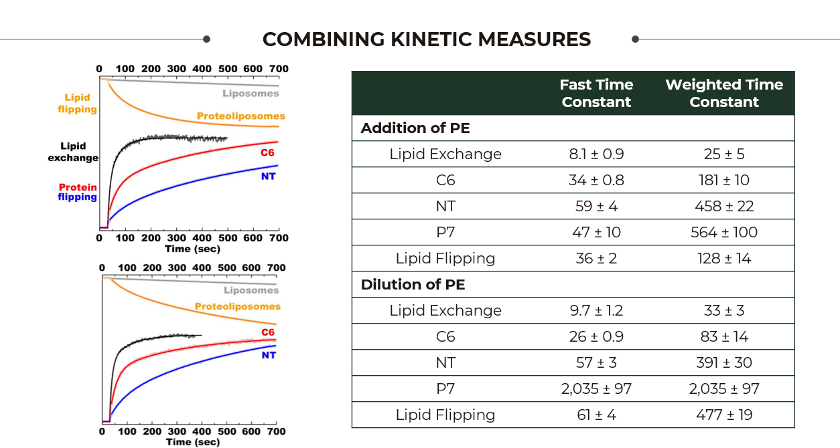
METHODS AND RESULTS
If you want people to understand what’s going on, put the results of each experiment with your description of the methodologies!

Slide 21
Make Your Own Figures!
Methodologies are easier seen than read
If a figure doesn’t emphasize the main results well, edit it
PowerPoint has great built in options
You can use BioRender to make STEM specific figures

Slide 22
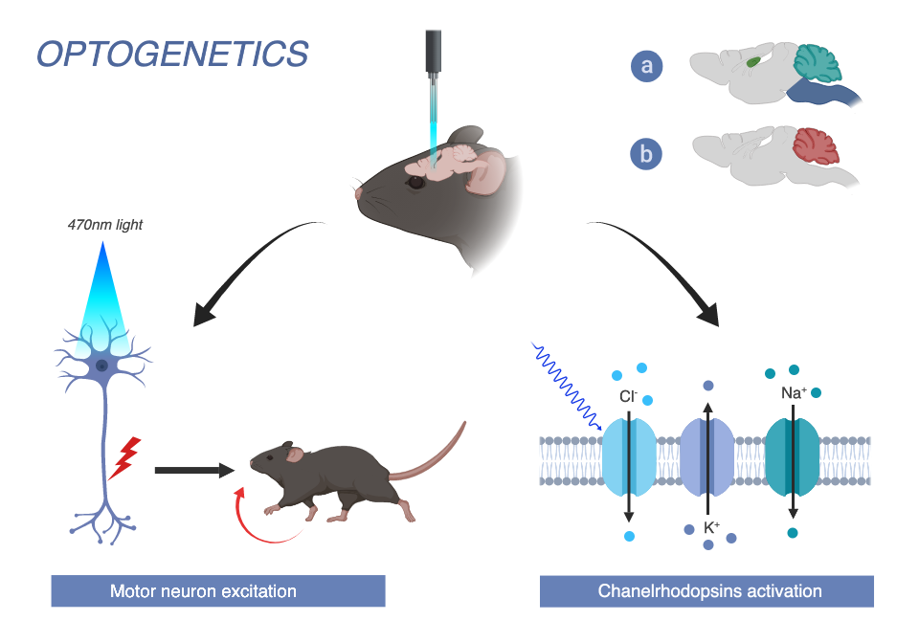
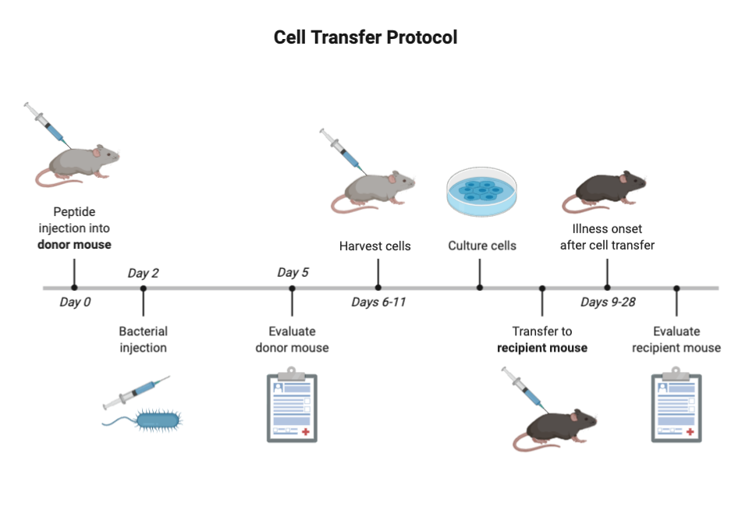
METHODOLOGIES
The ChR2-YFP gene was constructed by in-frame fusing EYFP to the C terminus of the first 315 amino acid residues of ChR2
VSVg pseudotyped lentiviruses were produced by triple transfection of 293FT cells with pLECYT, pMD.G and pCMVAR8.7.
Hippocampi of postnatal day 0 Sprague-Dawley rats were removed and treated with papain for 45 min at 37 C.
Hippocampal cultures were infected on day 7 in vitro using fivefold serioal dilutions of lentivirus
Cultured hippocampal neurons were recorded at approximately 7d post-infection.
Neurons were recorded by means of whole-cell patch clamp.
Transgenic mice and cell culture models were used that constitutively express human AB at high levels
Synthetic Ab1-40, AB1-42, scrambled AB42 and LL-37 peptides were prepared and purified
S. Typhimurium were pathologized prior to infection by incubation.
Female 5XFAD APP/PSI doubly transgenic mice that co-overexpress and co-inherit FAD mutant forms of human APP and PSI transgenes under transcriptional control of the neuron-specific mouse Thy-1 promoter
One-month old mice received a single injection if S. Typhimurium suspension
For immunofluorescence, mice were anesthetized and perfused
Brains were postfixed overnight and coronal sections were cut
Figure from BioRender Template Gallery
Protocol from: Boyden, E., Zhang, F., Bamberg, E. et al. Millisecond-timescale, genetically targeted optical control of neural activity. Nat Neurosci 8, 1263–1268 (2005).
Figure from BioRender Template Gallery
Protocol from: Kumar DK, Choi SH, Washicosky KJ, et al. Amyloid-β peptide protects against microbial infection in mouse and worm models of Alzheimer's disease. Sci Transl Med. 8, (2016)

Slide 23
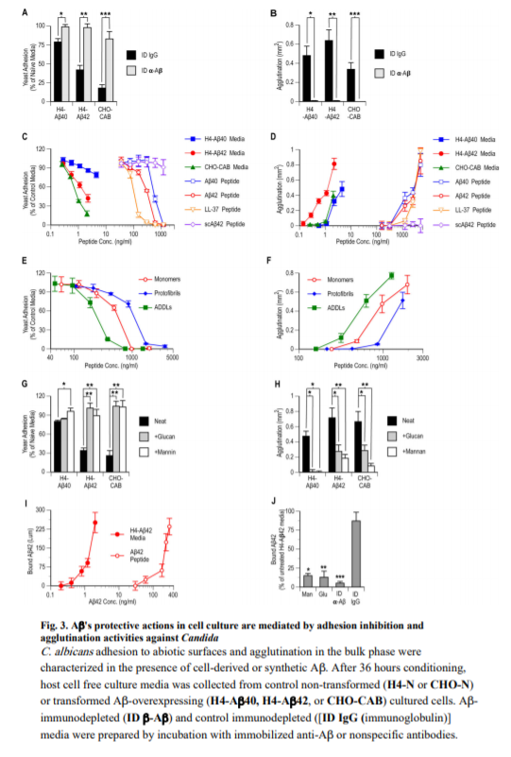
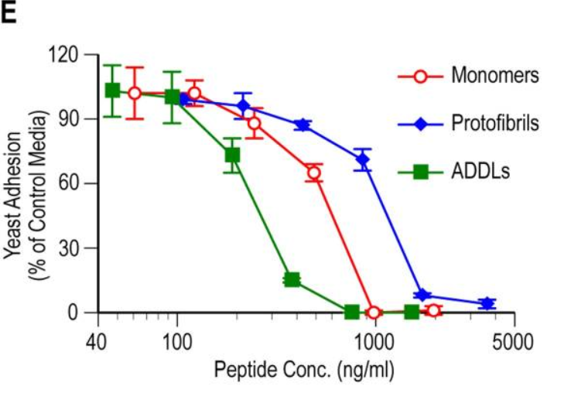

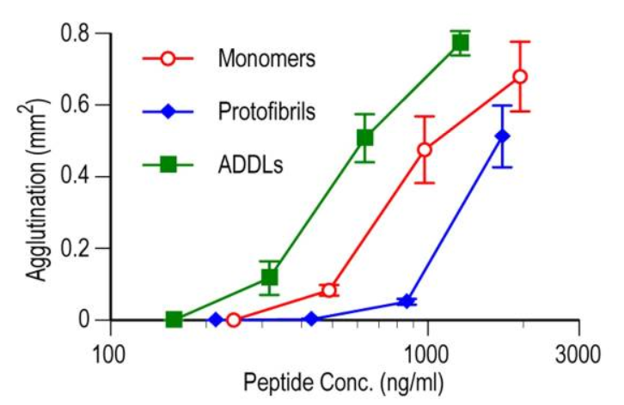
RESULTS
The protective actions of AB are mediated by adhesion inhibition (top) and agglutination activation (bottom)

Slide 24
CONCLUSION OR DISCUSSION
The conclusions of the paper should relate back to the goals you identified, so show how they do
If you have any critiques, include them
Prepare for questions

Slide 25
Designing a PowerPoint
That does the job AND looks nice

Slide 26
My biggest piece of advice for you is to make a template that represents you and can function in many settings

Slide 27
WHAT SHOULD A TEMPLATE HAVE?
Simple white (or black) background
High contrast colors
Readable fonts (sans serif, 18-40 pt)
A design that’s interesting to you
Some sort of personal “branding”
Distracting background
Colors that make it difficult to read
Background images
Overwhelming fonts

Slide 28
BASIC SLIDE “RULES” TO FOLLOW
Create each slide as a single message unit
Explicitly state that message
Use contrast
Use simple diagrams
Limit words, use visuals
Animations are your friend
But keep it simple and purpose-serving
Put references in small font at bottom of slide

Slide 29
ADDITIONAL TIPS FOR PRESENTATION
Include an outline at the beginning
Have an anchoring break between sections by either re-showing the outline or including a section title slide
Your slides should be a prop for you, not the other way around

Slide 30

The following are examples of both good and bad slide design, either given by myself or colleagues, or found online

Slide 31
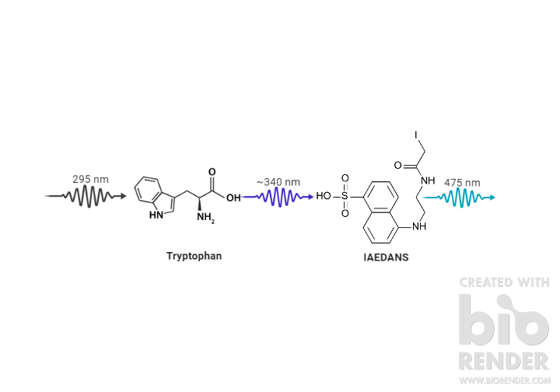
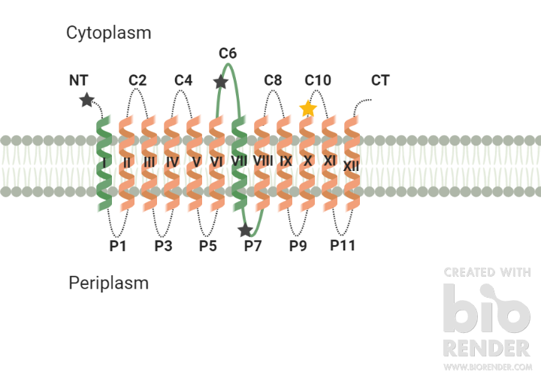
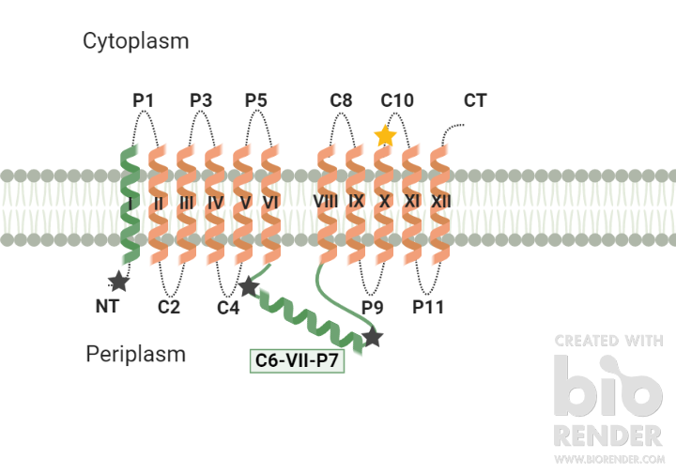
TOPOLOGICAL CHANGES VIA FRET
FRET donor: Diagnostic Trp replacements L14W, H205W, and F250W (gray stars)
FRET acceptor: Cys replacement (V331C) labeled by IAEDANS (gold star)
Notes:
Multiple topological isoforms of LacY stably coexist at steady state in the membrane governed by the level of PE in a dose-dependent manner
When properly oriented, the Trp positioned in NT or C6 is ~17 Å or ~19 Å from 331
When misoriented, most likely ≥ 40 Å
Because R₀ for the FRET pair Trp-IAEDANS is 22 Å, there should be a significant FRET loss when the EMDs are misoriented

Slide 32
The Completed Mechanistic Picture

Slide 33
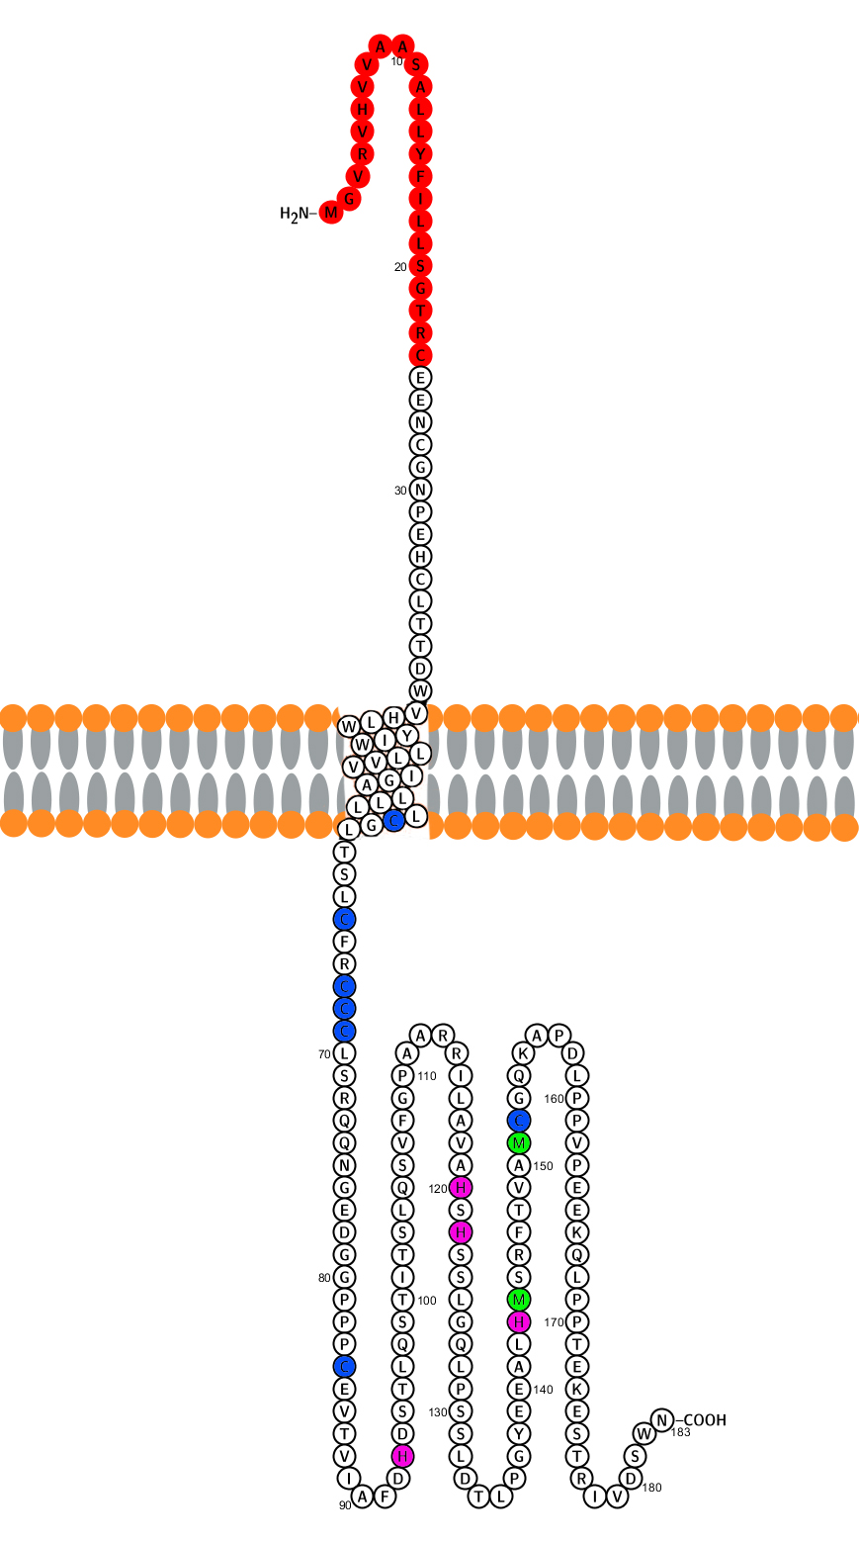
The Unknown
?
TMEM205
A largely uncharacterized transmembrane protein involved in cisplatin efflux/resistance
Interacting Proteins
Modulate proteins who influx/efflux cisplatin or regulate expression of pre-target resistance proteins
Currently Unknown
Unknown proteins/systems involved in pre-target resistance and principles of metal selection in known proteins
Notes:
Expand on TMEM205 and interacting proteins

Slide 34
Sample Preparation
Sample is dissolved in H₂O and brought to desired concentration before being pipetted onto a holey grid
Surface is blotted to remove excess sample
Grid is plunged in cryogenic liquid to flash freeze sample
Ethane: ~100K
Ethane/Propane mix: ~ 80K
N₂: ~ 65K
Helium: ~ 2K

Slide 35
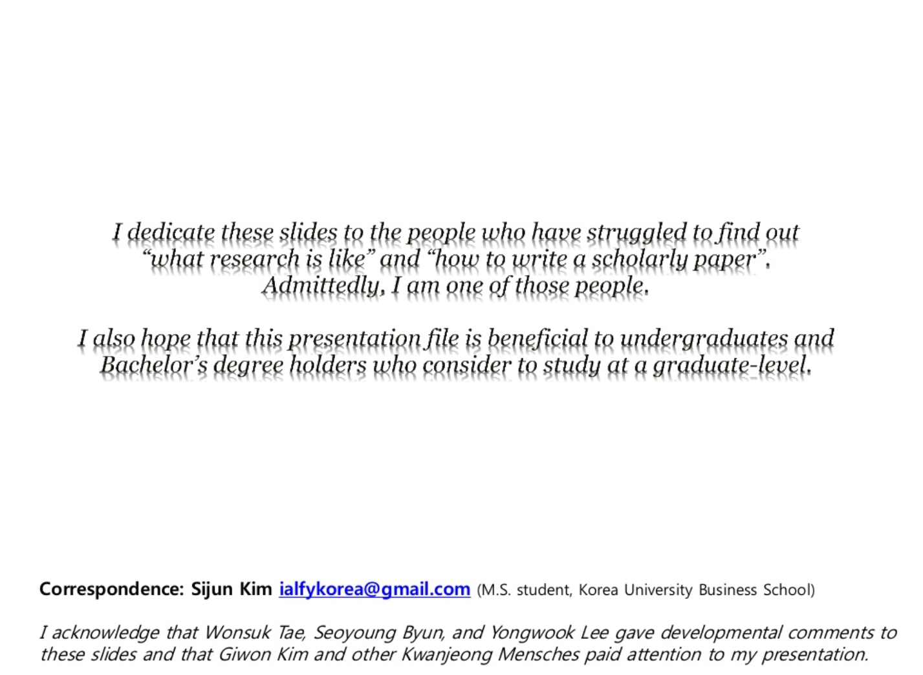

Slide 36
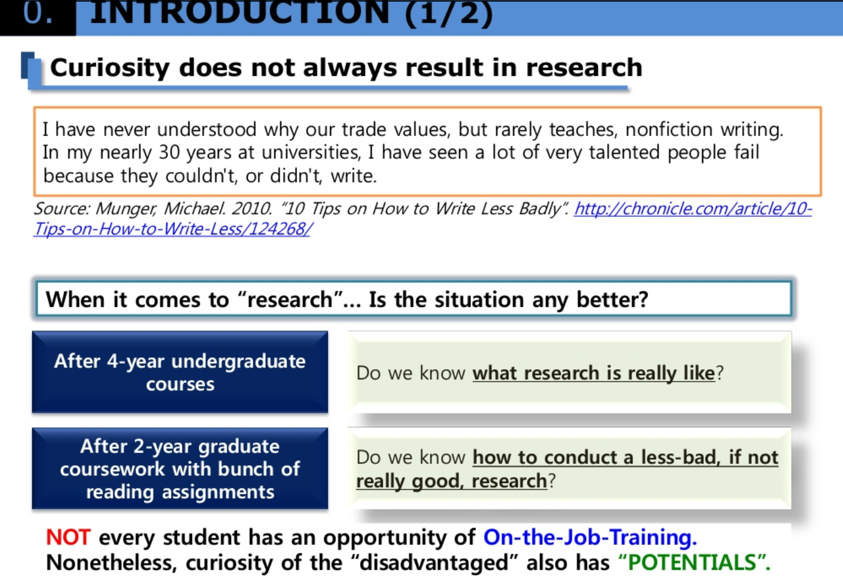

Slide 37
Making a Poster
Because you want to present some research in a different way, but Death by Poster is still real

Slide 38
BASICALLY, THE SAME THINGS
Effectively designing a poster follows a lot of the same rules as designing a PowerPoint, you just have “sections” instead of “slides”
Limit text
Use simple visuals
Highlight the important information
Keep background clean

Slide 39
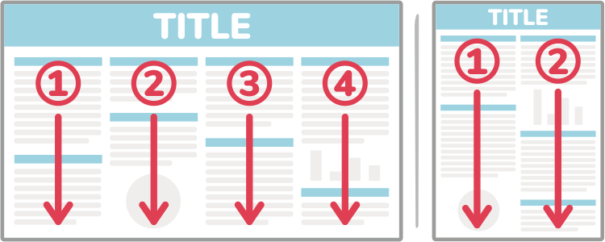
THINGS TO KEEP IN MIND
How people will read your poster
Keep colors simple (pick 2-3)
Use whitespace
Aim for symmetry

Slide 40


Slide 41


Slide 42
These are all just my tips and tricks. I’m not perfect, nor are my presentations, and you may find something that works better for you. But I hope I gave you a nice start.

Slide 43

THANKS!
Any questions?
You can find me at:
kira.mills@utdallas.edu
kiramills.com
Slides will be posted at utdnsa.org

Slide 44

Come to Part 3
Writing science: Tues 3/24
7:30p in GR 4.204
For NSA Members:
Sign-in to receive hours for attending tonight!
utdnsa.org/workshop2

